Slide 1
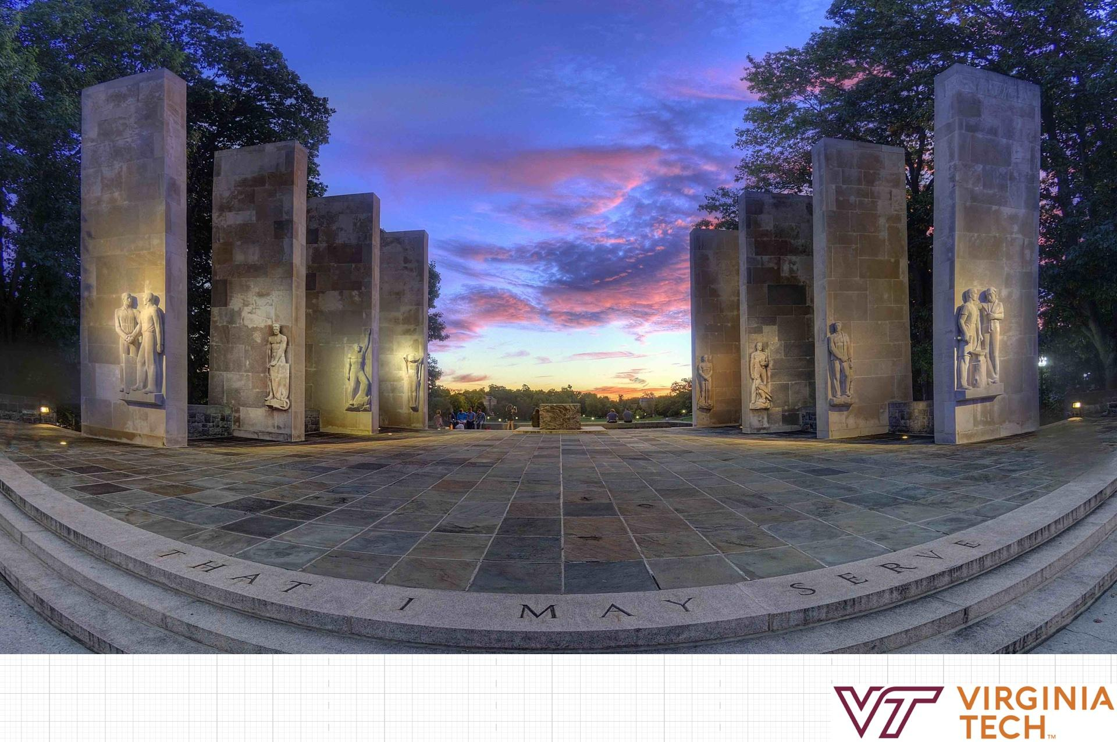
The Design and implementation of ML methods using existing commonly used ML toolboxes and platforms
FALL 2023 CS5806 guest lecturer: Hongjie Chen

Slide 2
Agenda
Introduction of ML toolkits and platforms
Design and Implementation
Discussion (ask about your applications)

Slide 3
ML toolkits and platforms - implement and test your ML algorithms.
Based on Python: mainstream, frequently updated, support from forums
Other languages:
Matlab, R: statistics
Java, C++: scalable, fast calculation
Julia, Scala, Lua, Prolog: have their specific purposes
Python packages: Tensorflow, PyTorch, Keras, scikit-learns, MXNet, Caffe, CNTK, Theano, DL4J, Fast.ai, Hugging Face, XGBoost, LightGBM, CatBoost, OpenCV, AutoML, etc.

Slide 4
Anaconda and Jupyter Notebook
Anaconda allows you to manage different environments
env 1: torch version 1
env 2: torch version 2
Jupyter Notebook is an interactive python software

Slide 5
Packages

Slide 6
Before deep learning
scikit-learns supports many ML algorithms:
linear models (linear regression, logistic regression, etc.)
decision trees
ensemble models (random forests, gradient boost, etc)
Naïve Bayes
KNN
SVM
Multi-layer perceptron (a.k.a., Neural Networks)
Also unsupervised: 1. clustering (K-mean, DBSCAN, etc.) 2. Dimensionality Reduction (PCA, t-SNE, SVD, etc.)

Slide 7
sklearn
also has many criteria for model evaluations
data splitting
cross validation
confusion matrix
…
To install and use:
pip install scikit-learn
import sklearn

Slide 8
Other ML packages
XGBoost, LightGBM, CatBoost: Gradient Boosting
More?

Slide 9
Deep learning - Big three (personal thought)
Tensorflow, Pytorch, MXNet
supported by big communities
fine control of models (e.g., change the NN structure during training)
many derivatives (dgl for graphs for all, timm for Images from pytorch, torchaudio for audio from pytorch, gluonts for time-series from mxnet)
Note: go to their pages and see how to install them.
name1 and name2 can be different in pip install name1 and import name2

Slide 10
No need for complicated functions?
Keras, CNTK
Caffe: originally for CV

Slide 11
Other packages
Theano: defines computational graphs
DL4J: DL for JVM
Fast.ai, Hugging Face: define many popular models
OpenCV, AutoML, etc.: for more specific uses

Slide 12
Design Workflow

Slide 13
Design - workflow
Prepare data
Implement your model
train your model
Get a trained model. Done!

Slide 14
Life can be more complicated
We need to break down steps to resolve these challenges:
Memory is not big enough to store all data at a time.
How do we know if the trained model works?
We want to use some strategies during training, for example, reduce the update speed when the loss is small.
…

Slide 15
Design - revised workflow
Prepare data
support data transformation and splitting
adopt train/val/test set if possible
Implement your model
train your model
load your data in a generator or an iterator manner so that it yields a batch at a time
train for several epochs, allows learning rate to be updated in different epochs, use a patience indicator to stop after the loss doesn't reduced after certain epochs
Get a trained model. Done!

Slide 16
Life can be even more complicated
We need to add more steps to fulfill these needs:
reproduce your (best) result
make the training procedure easier to understand
make your model easier to understand
monitor your model weights update
train several models with different hyperparameters and select the best one
…

Slide 17
Design - revised workflow
Prepare data
support data transformation and splitting
adopt train/val/test set if possible
Implement your model
train your model
load your data in a generator or an iterator manner so that it yields a batch at a time
train for several epochs, allows learning rate to be updated in different epochs, use a patience indicator to stop after the loss doesn't reduced after certain epochs
Get a trained model. Done!

Slide 18
Discussion - more to consider?
Prepare data
support data transformation and splitting
adopt train/val/test set if possible
Implement your model
train your model
load your data in a generator or an iterator manner so that it yields a batch at a time
train for several epochs, allows learning rate to be updated in different epochs, use a patience indicator to stop after the loss doesn't reduced after certain epochs

Slide 19
Let's see some real examples
CV: ResNet with PyTorch: https://github.com/Lornatang/ResNet-PyTorch
Audio: Wav2Net: https://github.com/khanld/Wav2vec2-Pretraining/blob/main/run.py
A lot more on hugging face https://huggingface.co/
…

Slide 20
Discussion: your applications

